Slide 1

Mid-Bootcamp Project- Villarreal Club de Fútbol
Alo Askari

Slide 2

The Data
Originally various Excel files-
Df = team data, information and individual statistics for every player to play for Villarreal since the 1995-1996 season e.g. starting appearances
Df_averages = team averages for each season, based on the data provided in df e.g. average minutes played
Df_european_comps = information and statistics for every cup competition they’ve played in they’ve gone on e.g. round of tournament
Df_goals = statistics for goals scored and conceded as a team for each season, a valuable KPI e.g. goal difference (net goals)
Cleaned and merged the data frames together into a “master_df”
Applied various functions to clean it and make it make sense

Slide 3
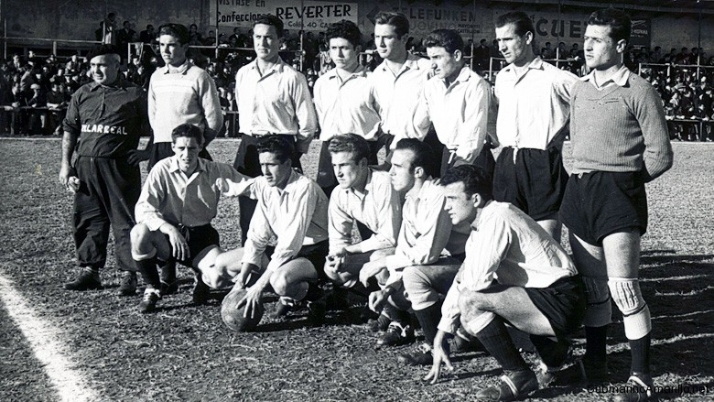
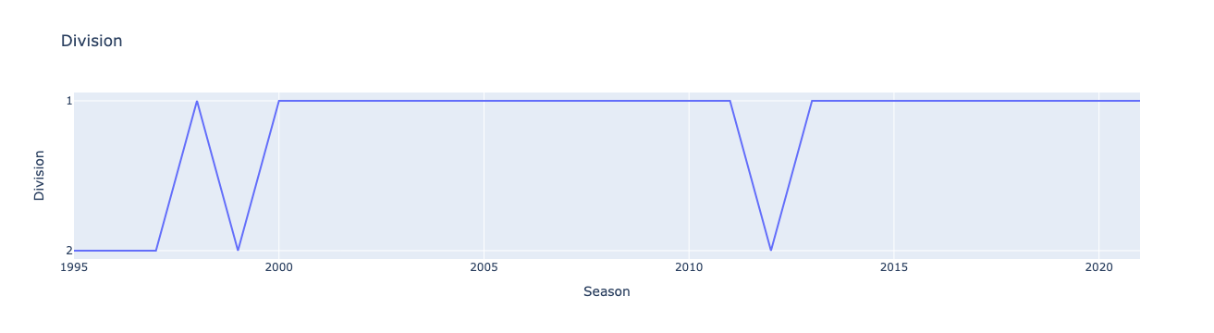
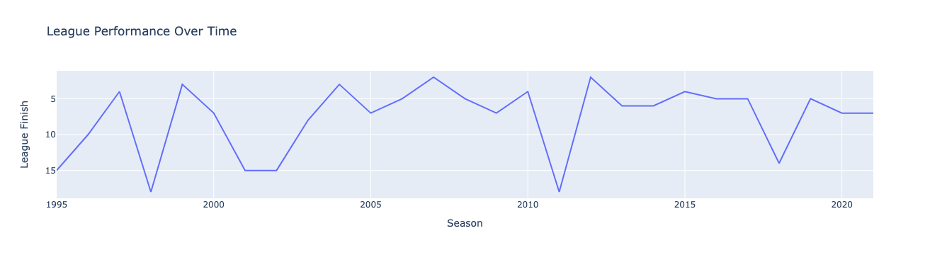
League Performance- Historically

Slide 4
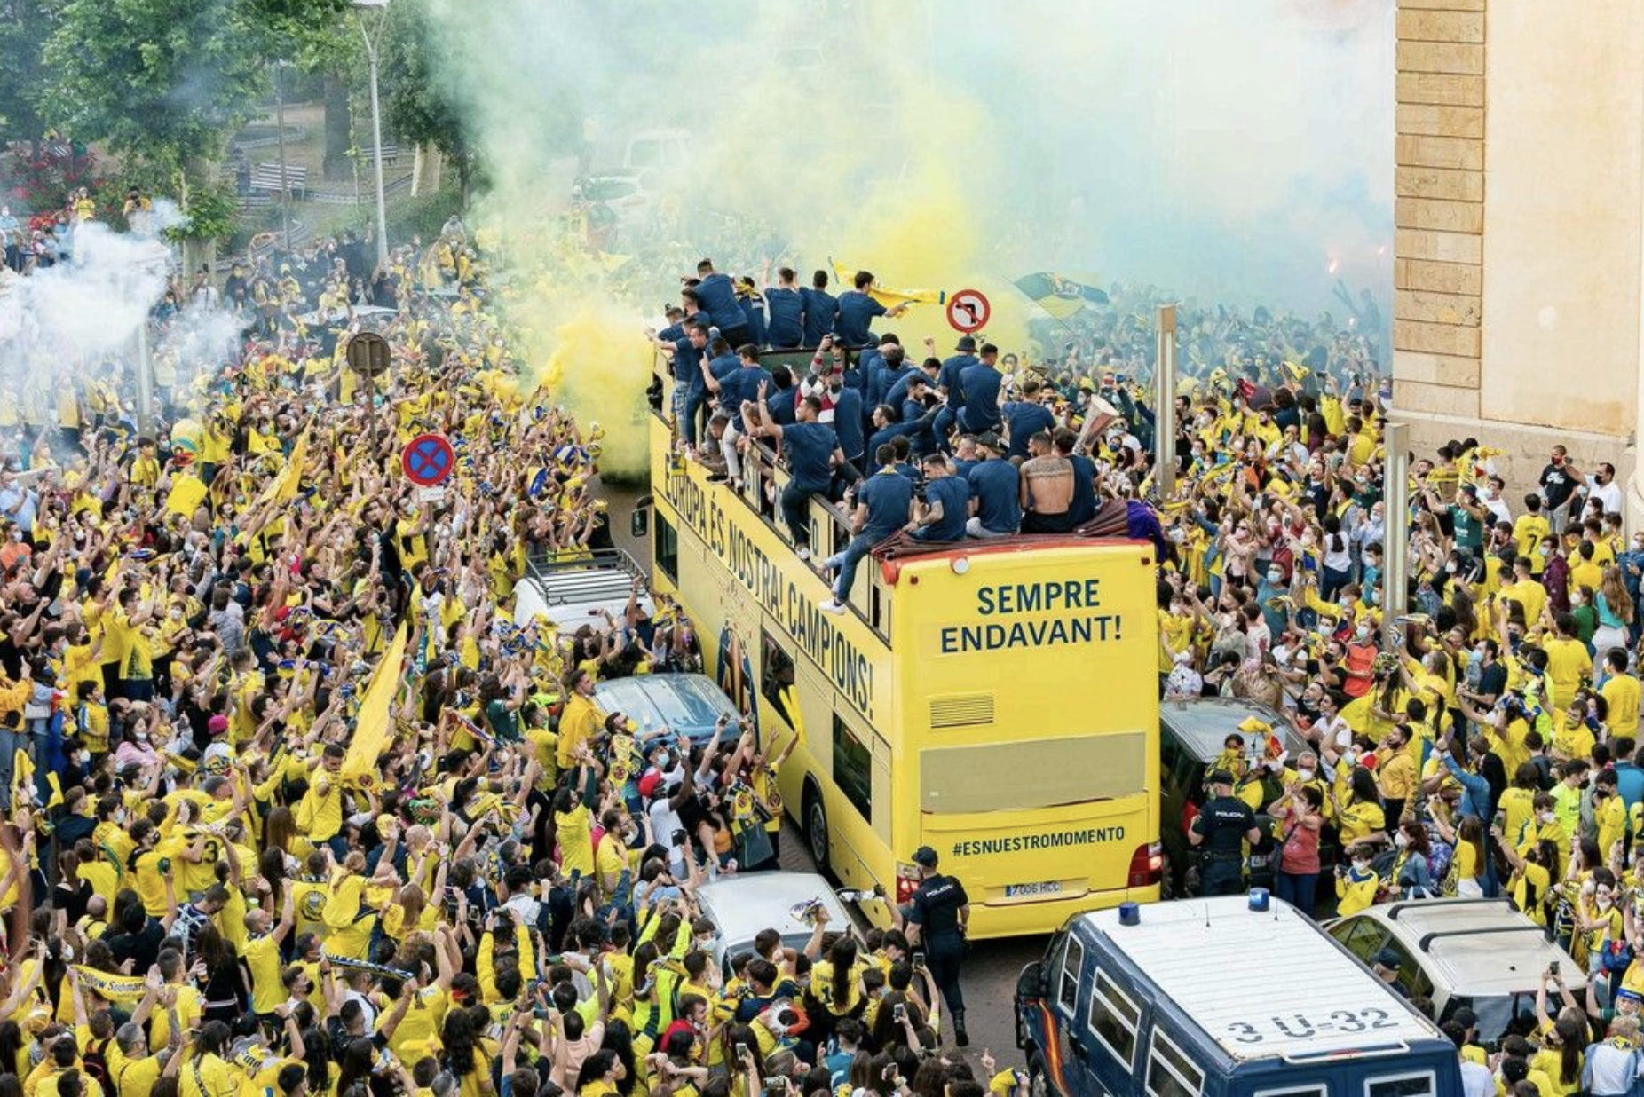
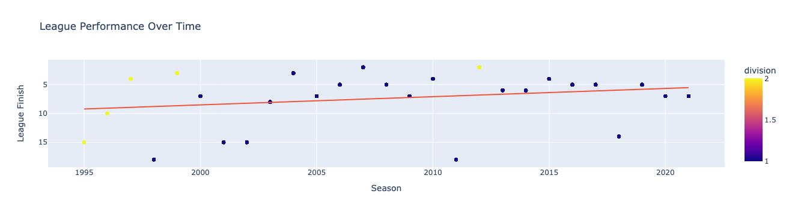
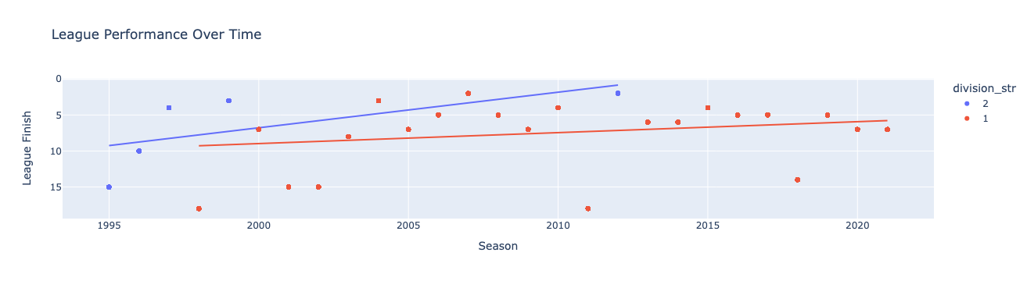
League Performance- By Division

Slide 5
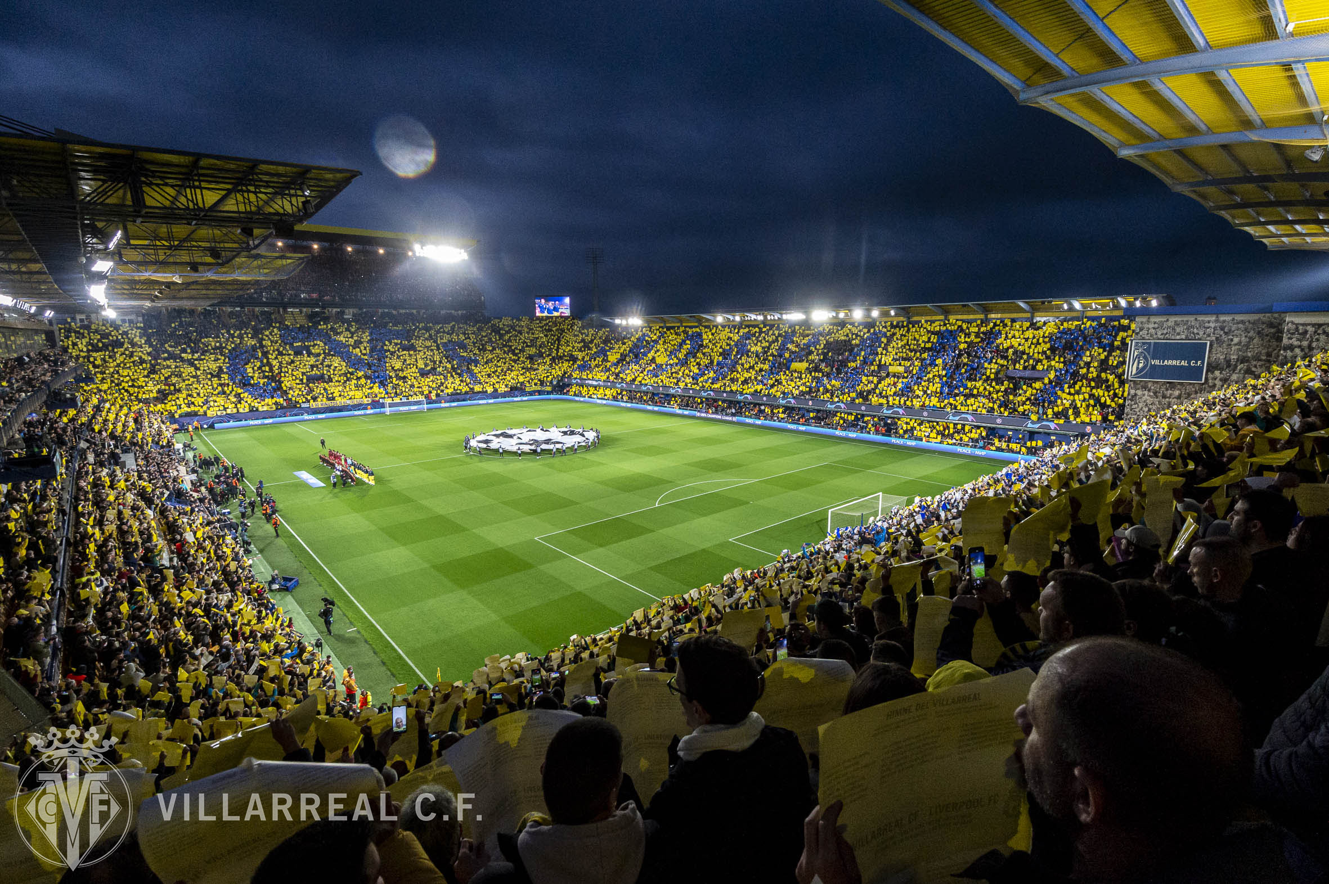
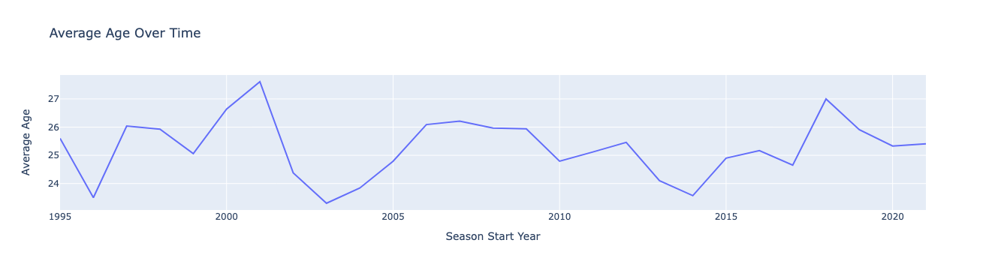
Average Age- Historically

Slide 6
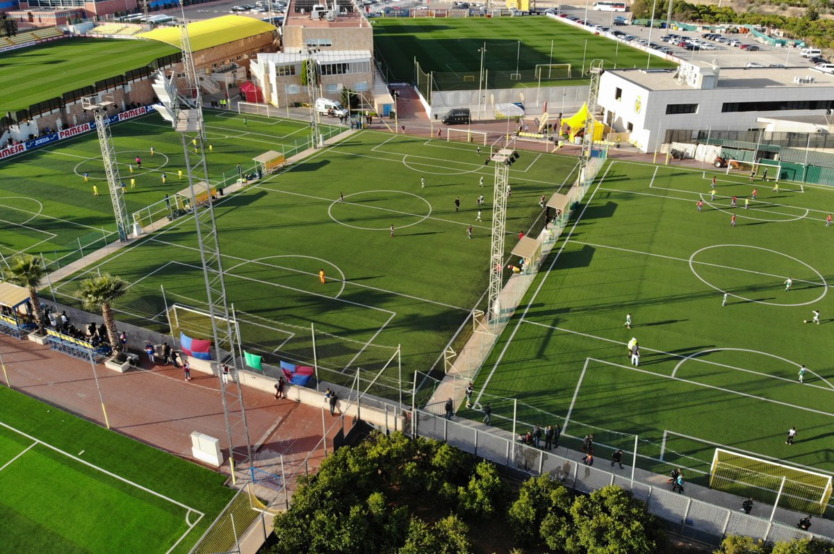
Homegrown Players

Slide 7

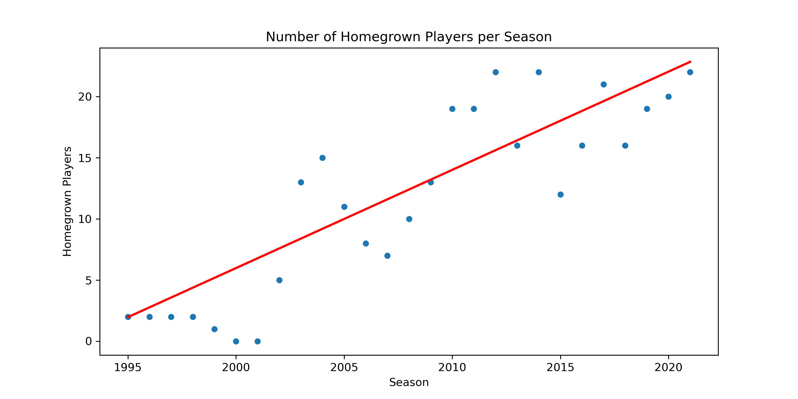

Slide 8

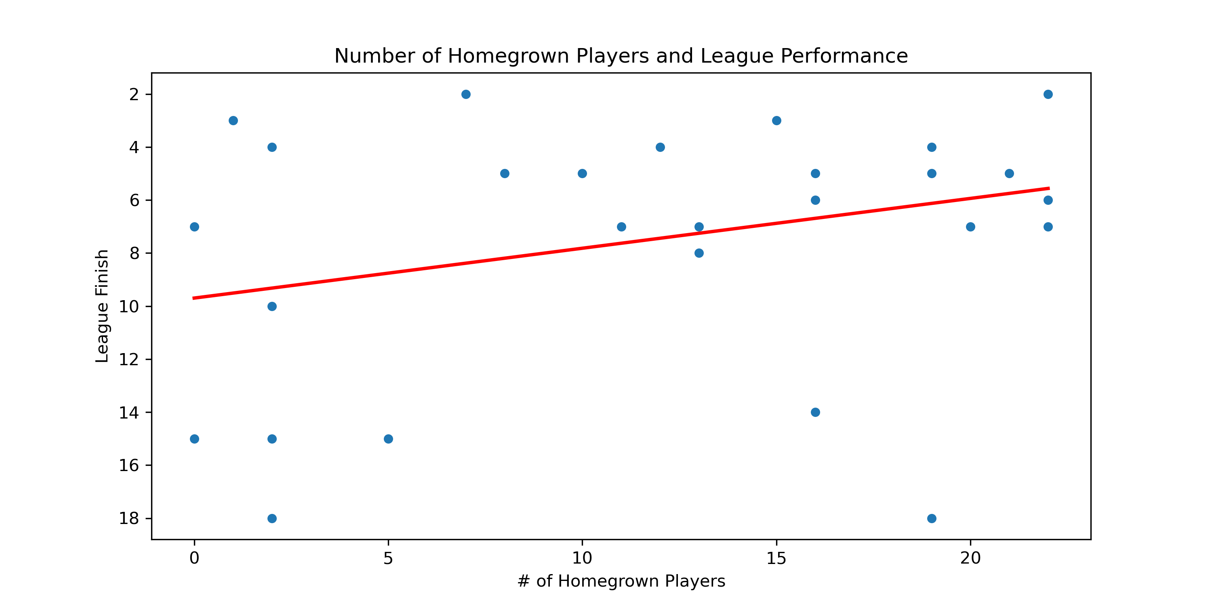

Slide 9

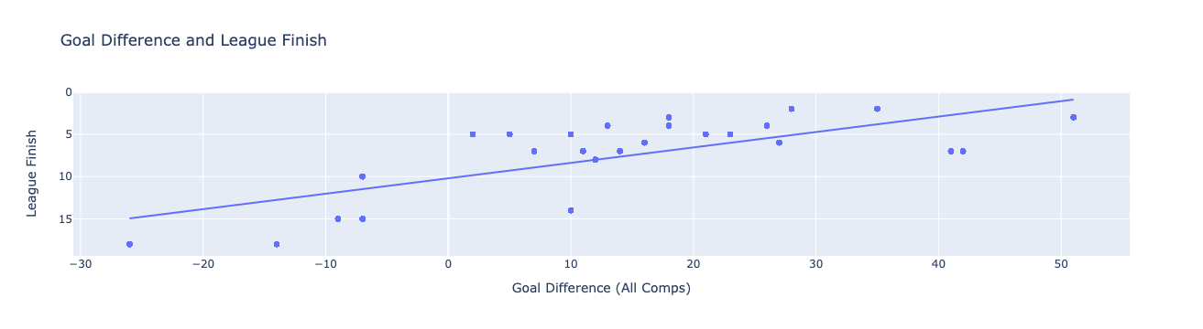
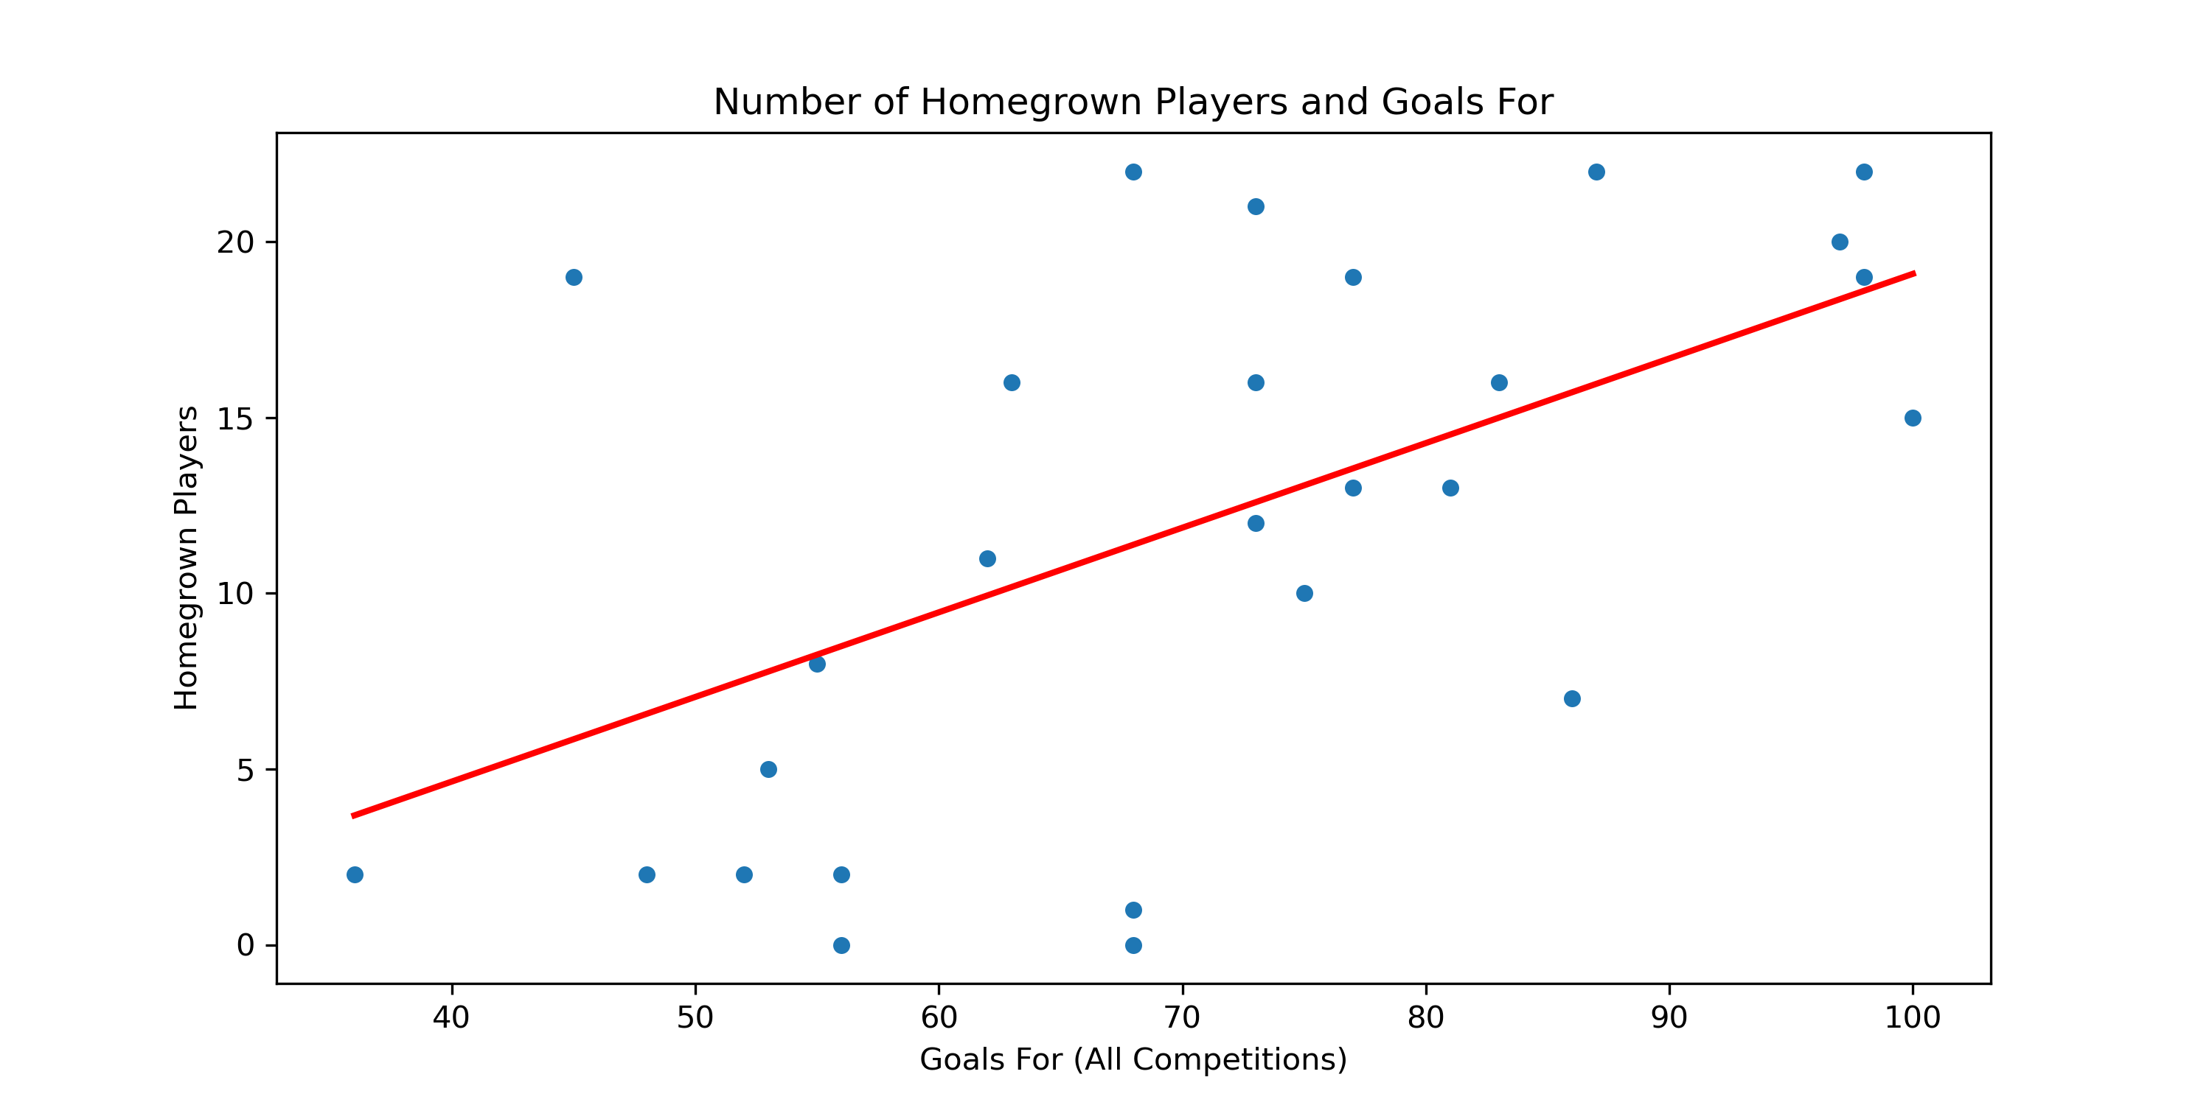
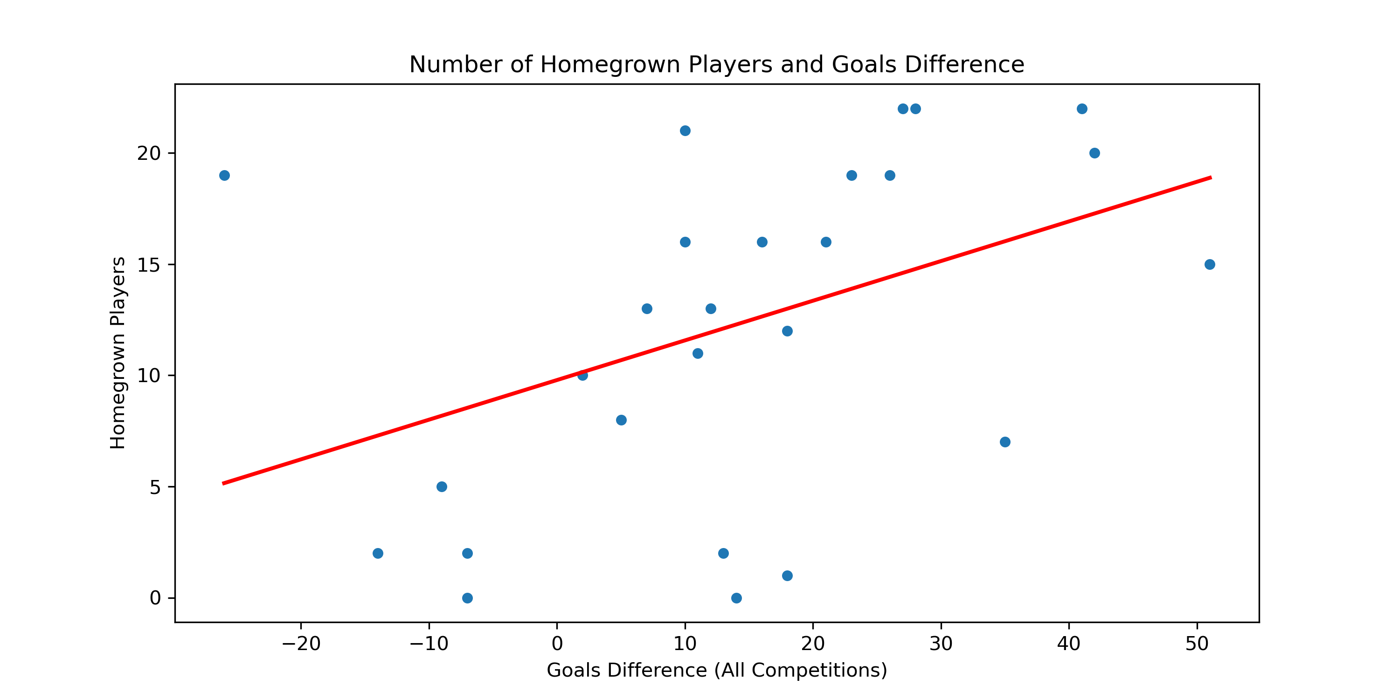
Goal Difference, League Performance and Homegrown Players

Slide 10

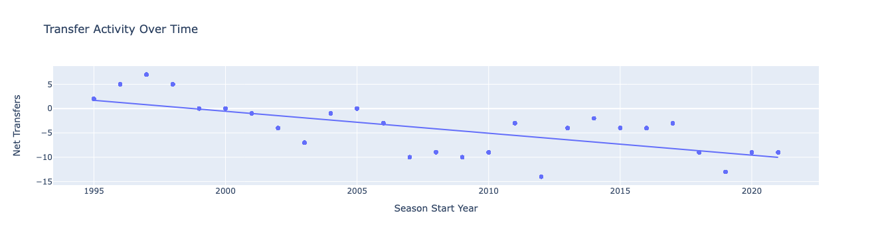
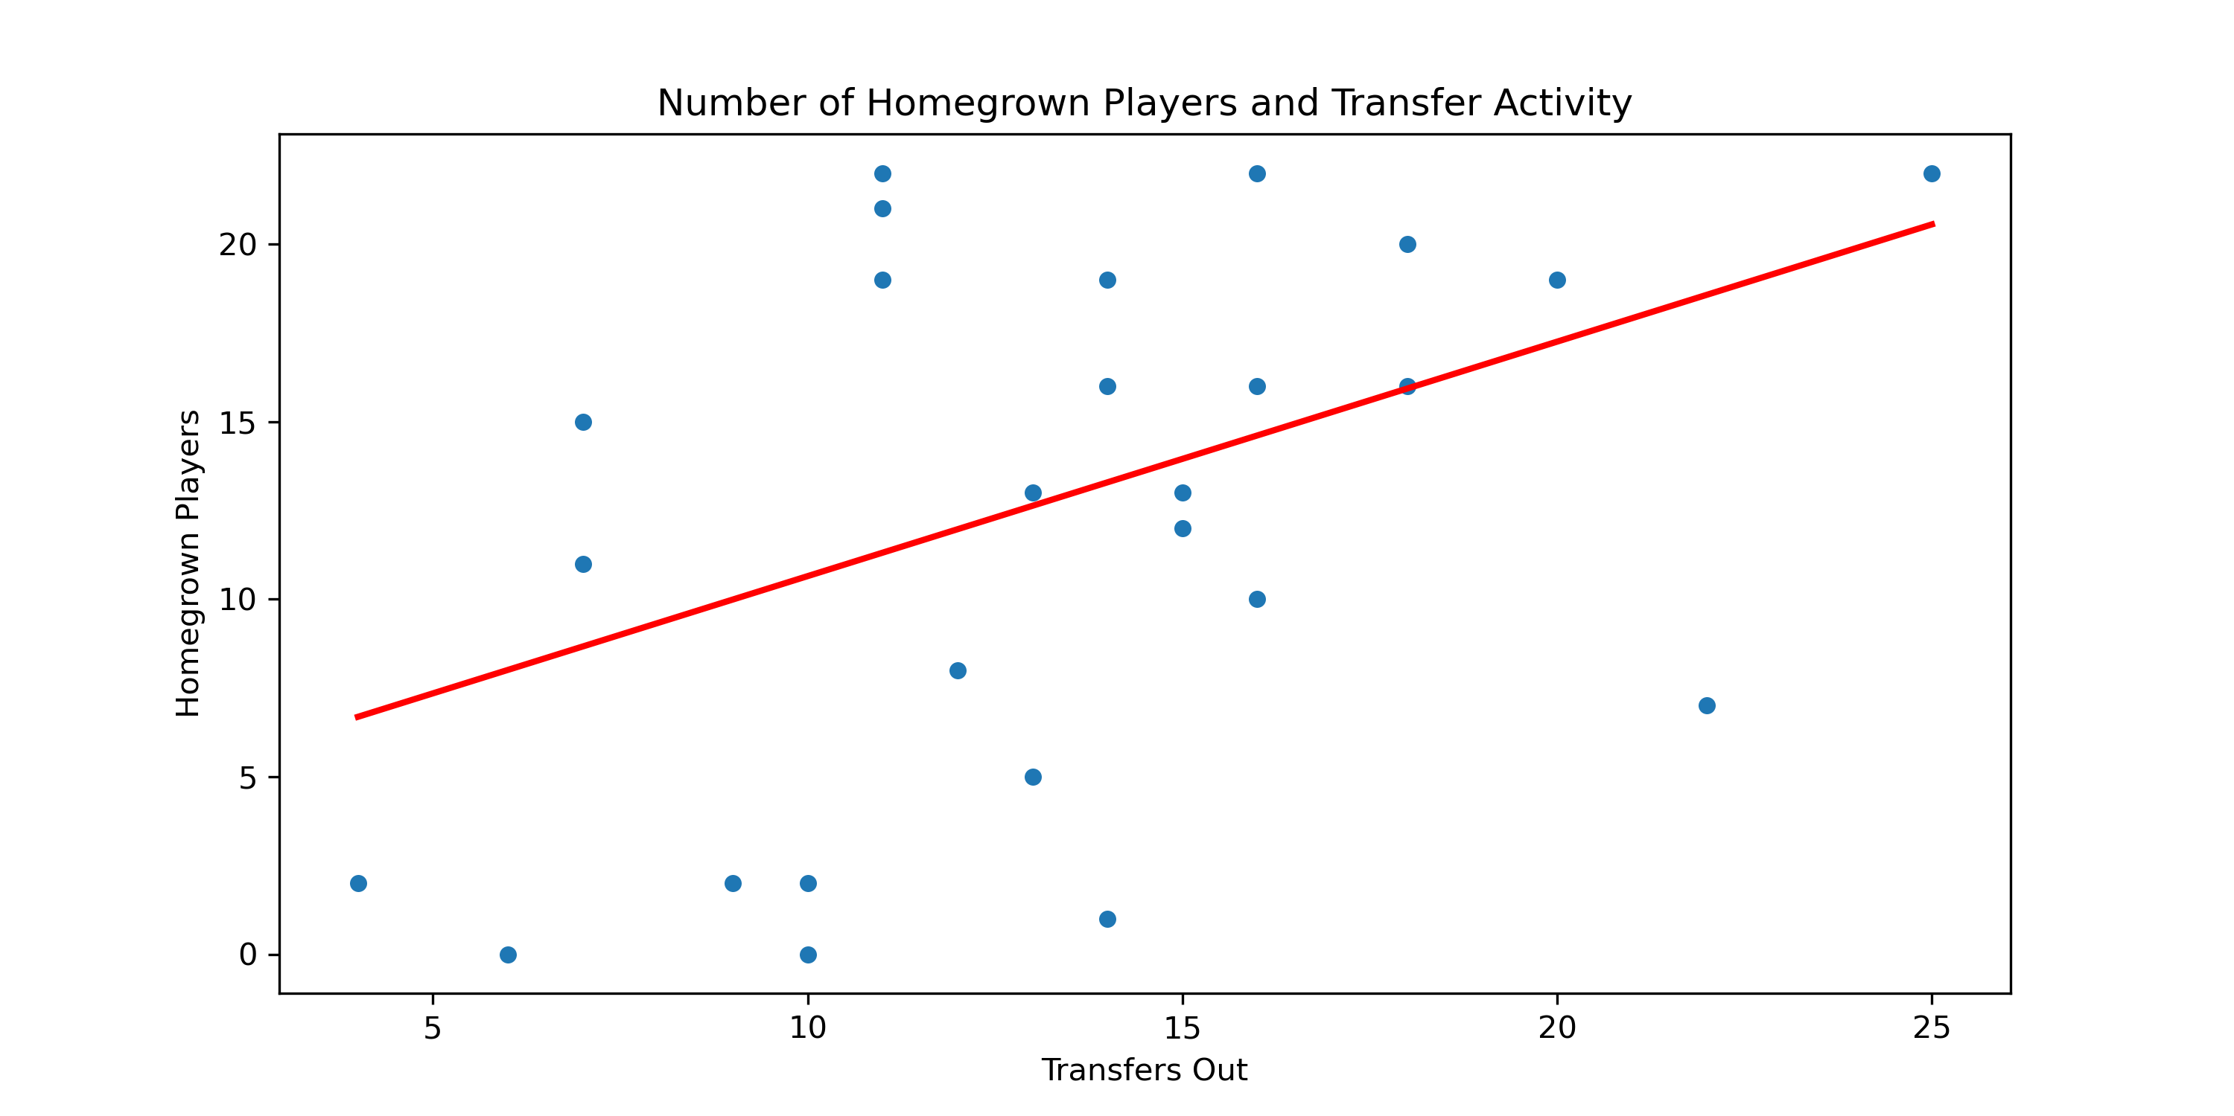
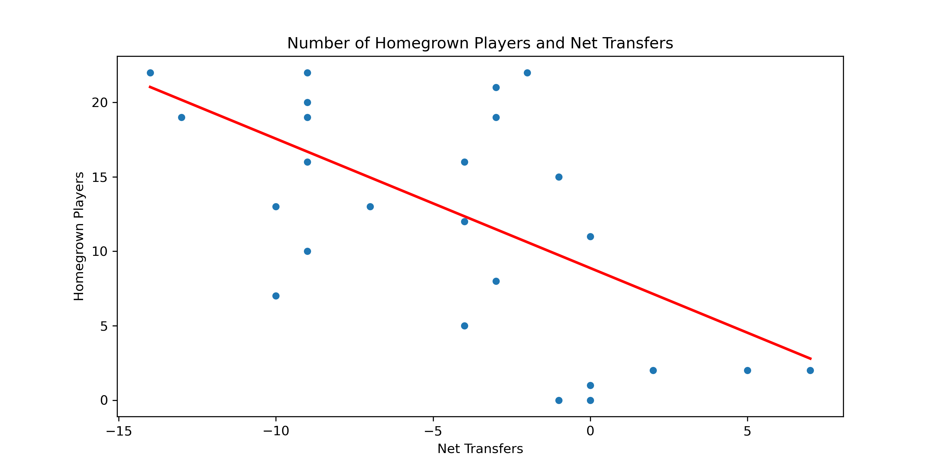
Transfer Activity and Homegrown Players

Slide 11
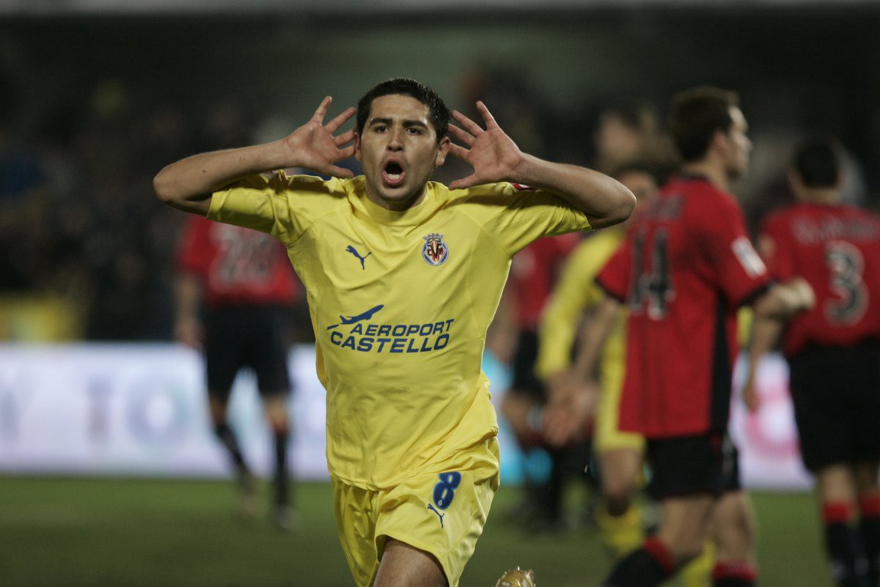
Model Performance
Linear Regression Model- prediction score: 0.994992063890612
For the Test Set-
The r2 of the model is: 0.995
The mean absolute error of the model is: 0.375
The mean squared error of the model is: 0.242
The root mean squared error of the model is: 0.492
For the Train Set-
The r2 of the model is: 0.996
The mean absolute error of the model is: 0.351
The mean squared error of the model is: 0.218
The root mean squared error of the model is: 0.467
KNN-Neighbours Test-
The r2 of the model is: 0.921

